Slide 2


INTRODUCTION
Presenter :
Soumya Gupta
(152915)
Notes:
O Logo de espadas deve ter mais espaço das pontas abaixo. Sugerir outros tipos de imagens/ telefone, fones.

Slide 3

What is Linux ?
Linux is the open source operating system.
It is Multi-user, Multitasking and Multiprocessor.
Coexists with other operating systems.
Runs on multiple platforms.

Slide 4
ADVANTAGES
Cost
Stability
Compatibility
Free to do what you like
Virus free
Network support
Security
Has short debugging time

Slide 5
History of Linux
1984 - Richard Stallman starts GNU project.
1987- MINIX was first released which inspired creation of Linux.
1991 - Linus Torvalds writes 1st version of Linux kernel.
1992 - released the kernel under GNU.

Slide 6


Open Source Software
It is software with source code that anyone can inspect, modify and enhance.
Open source software is different from free
software. All free software are not open source software.
Open source is a philosophy, that promote free redistribution and access to end product design and implementation details.
The word free in OSS refers freedom not the cost.

Slide 7

Advantages of open Source software
Availability of source code.
Does not depend on vendors.
Quality in open source
software is better.
Lesser hardware cost.

Slide 8
Disadvantages of Open Source Software
Not easy to use and requires a certain learning curves.
Incompatibility issue with software and hardware (3rd party drivers).
Bad codes and some unqualified people uses it.
Less support available when things go wrong.
Less user friendly.

Slide 9

Linux Distribution
It is an operating system made from a software collection, which is based upon the Linux kernel and often a package management system.

Slide 10
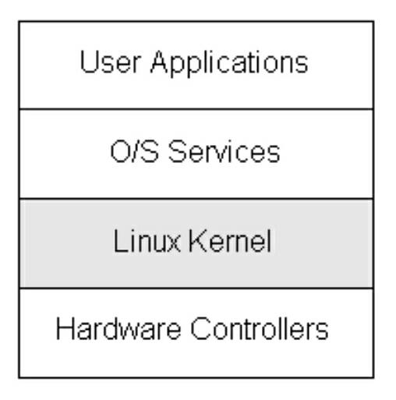
Linux Subsystems
Subsystem is a self-contained system within a larger system.
Linux subsystem includes :
User Applications – Applications used by end users for processing.
Shell – An interface to kernel, hiding complexity of kernel functions from users. Takes commands from user and executes kernel functions.
Kernel – Core component of Operating System, interacts directly with hardware, provides low level services to upper layer components.
Hardware layer – It consists of all peripheral devices (RAM, HDD, CPU etc).

